Slide 1


Machine Learning
With python
lin1: linear
algorithms
linear transformations
Notes:
Layout objects pulled from: https://slidesgo.com/
All icons are from: https://thenounproject.com/

Slide 2
Colab workbook
Link: click for access

Slide 3
Model Types
Algorithm Types
Tree-based
segment feature space into simple regions and then make prediction based on which region a new record falls into
Classification
goal is categorical, discrete
algs: decision trees, logistic regression
Regression
goal is number, continuous
algs: linear regression, CART
Linear-based
detect linear relationships among features and then make prediction on a response variable with infinite possibilities
Both tree and linear models have both classification and regression algorithms!

Slide 4
How to know if you should do regression?
When would an alternative make more sense?
The dependent variable is continuous.
The relationship between independent and dependent variables is linear (passes assumptions)
You are interested in quantifying the relationship and making predictions.
The dependent variable is categorical
The relationship is non-linear.
You have complex or high-dimensional data.
Features are multicollinear (correlated)

Slide 5
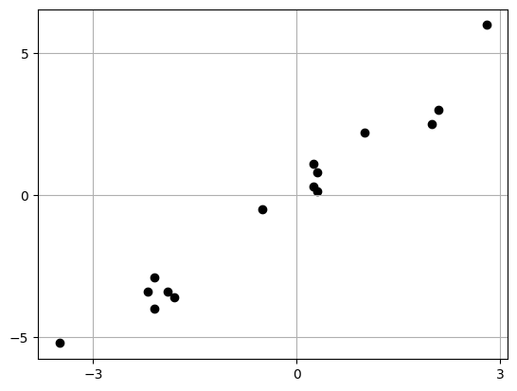
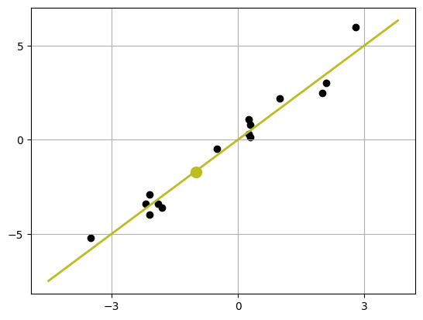
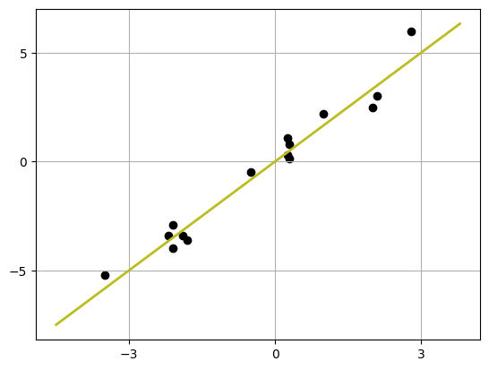
Big Idea: find the line that best fits the data
The equation of this line is y = mx + b, and we would like to find the best choices for m and b
y = 5/3 x
We will see how to get an exact form of this line in a bit, but for now let’s guesstimate it.
1. if x = 0, then y is around 0
2. goes from ~(0,0) to ~(3,5)
which is a change up 5, right 3 → 5/3
3. y = mx + b → y = 5/3 x - 0
If we want to predict a y-value given an x-value, we have a way to get that information!
If we have a point with an x-value of -1, we would expect y to be 5/3 *-1 → -5/3 or ~-1.7

Slide 6
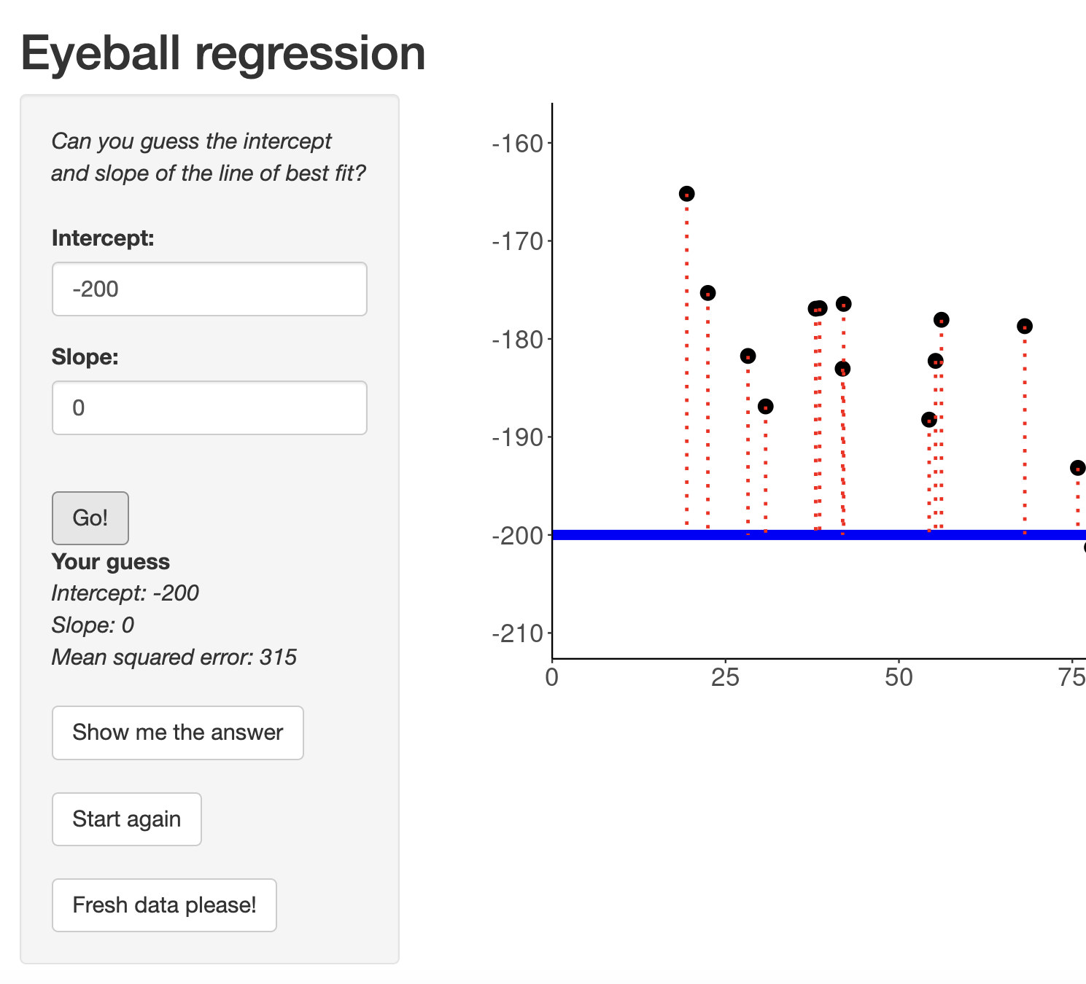

exercise
Let’s practice finding the best fitting straight line with a new set of points using this app
Goal: eyeball a line to get the smallest MSE value
https://sophieehill.shinyapps.io/eyeball-regression/

Slide 7
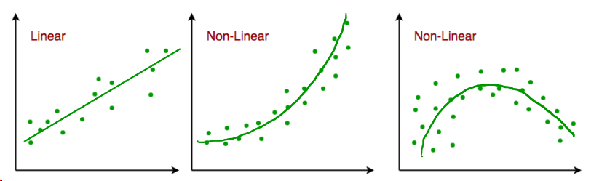
..what if our data isn’t linear?
We can do some data cleaning to transform our data into something that looks linear!
Switch over to the colab workbook

Slide 8
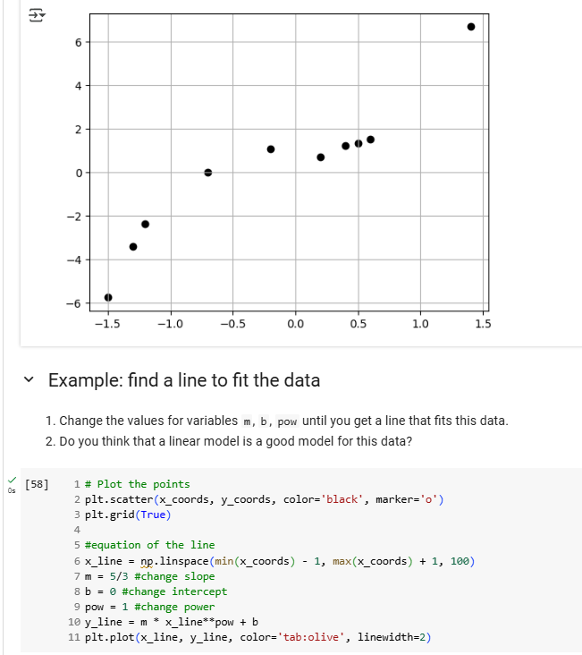
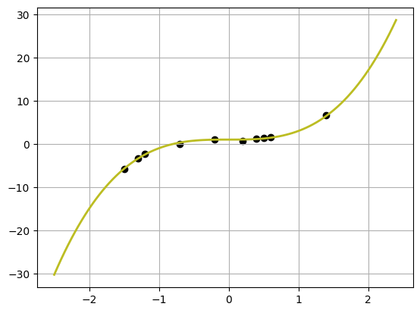

example
Update the values of m, b, and pow until you get a line to fit the data to the right
Do you think that a linear model is a good model for this data?
m = 2, b =1, pow = 3
Not a great fit

Slide 9
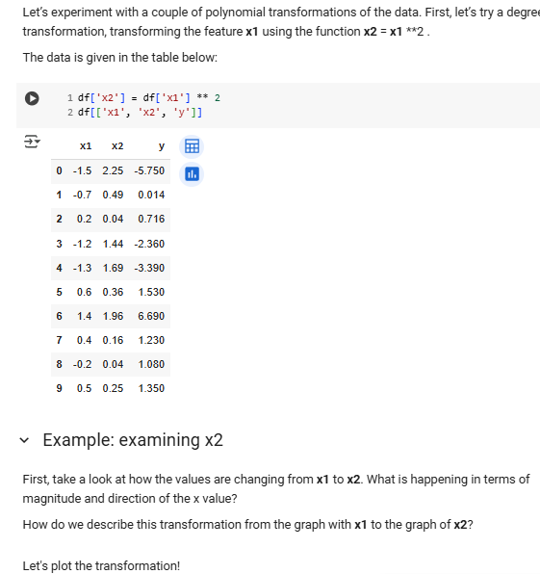
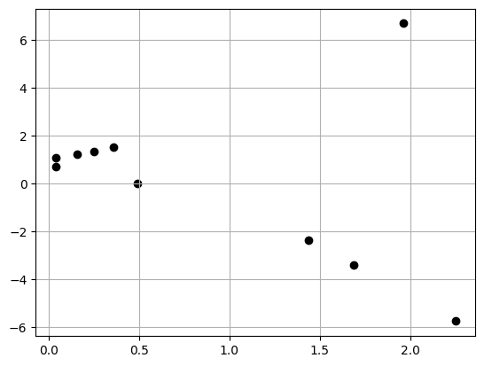
Let’s experiment!
What is happening in terms of magnitude and direction of the x-values going from x1 to x2?
After plotting the transformation, does a linear model seem like a good fit?
magnitude: above 1 getting larger, below 1 shrinking
direction: x2 are all positive
Still no (pesky point in upper right)

Slide 10
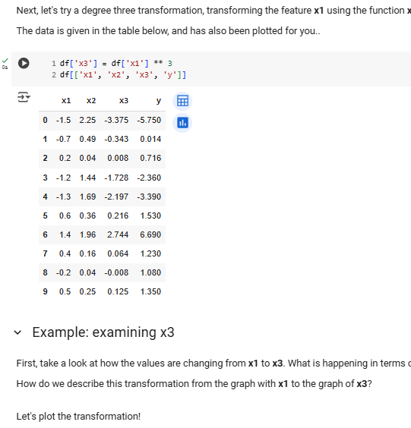
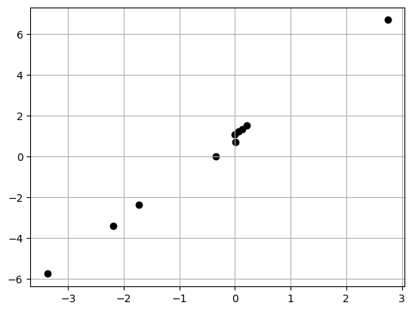
Let’s experiment!
What is happening in terms of magnitude and direction of the x-values going from x1 to x2?
After plotting the transformation, does a linear model seem like a good fit?
magnitude: above 1 getting larger, below 1 shrinking
direction: x3 has original direction
Yes! (finally)

Slide 11
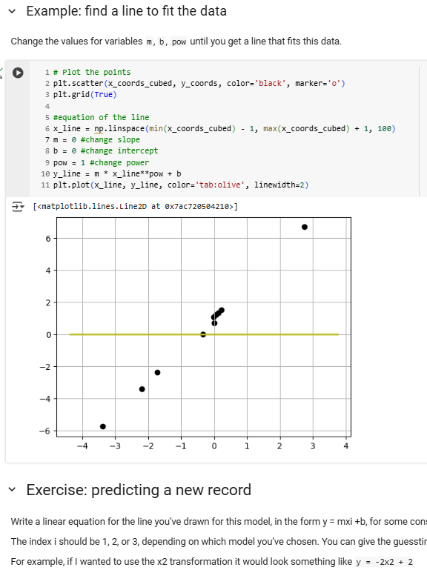
Update the values of m, b, and pow until you get a line to fit the data
Once you have a good fit, write down the equation.
Then use that equation to predict the y value for a new data point, which has a value x1 = −0.5
m = 2, b =1, pow = 1
y = 2 * x3 + 1 → y = 2 * (x1 **3) + 1
y = 2 * (-0.5 **3) + 1 → 0.75

Slide 12
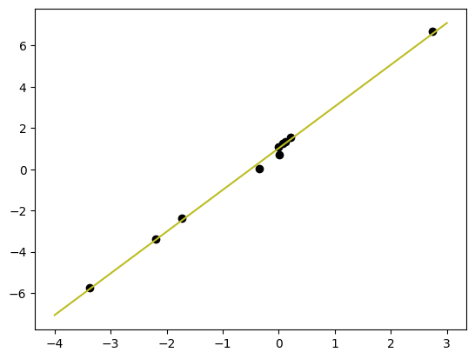
Linear Regression Equation
Equation of a line: y = mx + b
Data as points (x1, y1) … (xn, yn)
Simple linear regression: ŷ = β₀ + β₁x
βi tell us if negative or positive association between response variable ŷ and feature x
Big Idea: find the line that best fits the data

Slide 13
Null Hypothesis and p-values
Typically we have a null hypothesis that we are trying to disprove with evidence given in the form of a test statistic and associated p-value.
We compare against the null hypothesis, namely that βi (any parameter we have associated with a feature i.e. not intercept β₀ ) is 0.
If any βi is close to 0, usually that feature is not very useful BUT there may be other factors to consider and a different model could be a better fit.
Big Idea: find the line that best fits the data

Slide 14
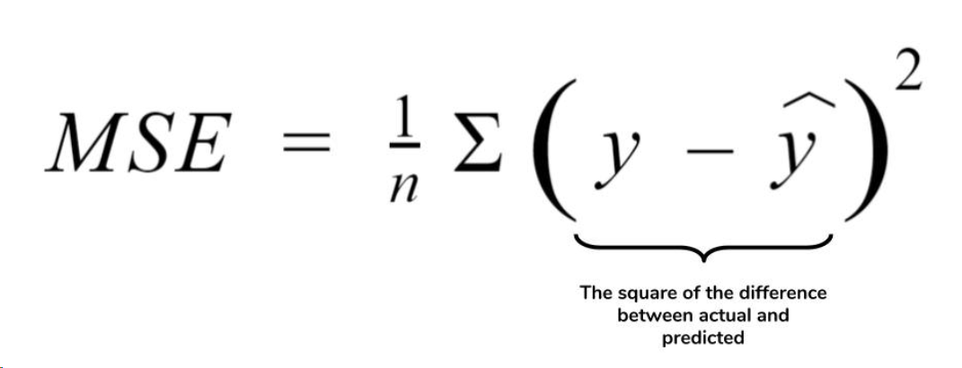
Prediction and Cost functions
Data as points (x1, y1) … (xn, yn)
Simple linear regression: ŷ = β₀ + β₁x
Our regression equation above is called the prediction function.
To fit a prediction function, we need a way to quantify it. This is where the cost function comes in. Cost function will weigh the best fit using chosen metric:
Goal: to find β₀, β₁ that minimize MSE
Big Idea: find the line that best fits the data

Slide 15
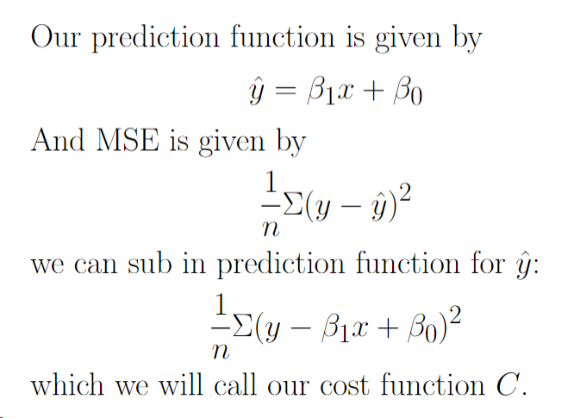
Optimization: find β₀, β₁ that minimize MSE
Since our cost function C is a quadratic function and we want to minimize β₀ and β₁, we need to figure out how these variables change with respect to C changing.
Hopefully this sounds familiar to you. To solve this, we need calculus!

Slide 16
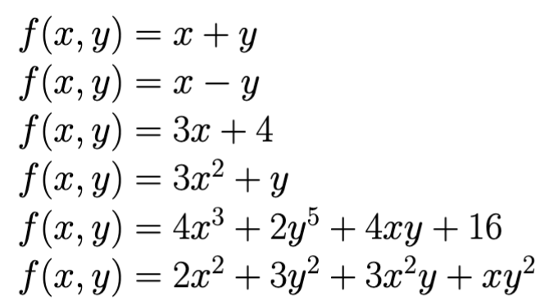

Review
Partial derivatives are taking the derivative of a function with respect to a single variable
For example, the partial derivatives for the function f(x,y) = 2x + 3y³ are:
df/dx = 2 and df/dy = 3y²*3 = 9y²
Grab a partner, and a whiteboard marker and find the partial derivatives of the other functions listed

Slide 17
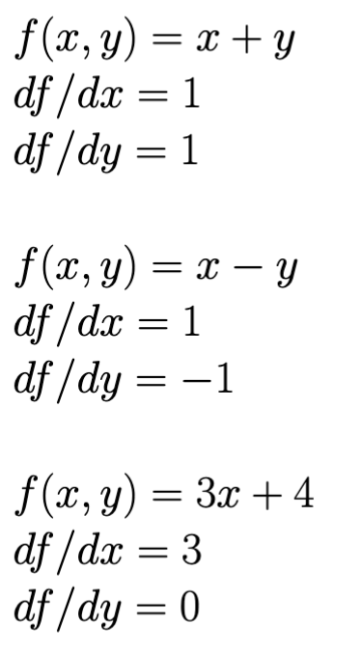
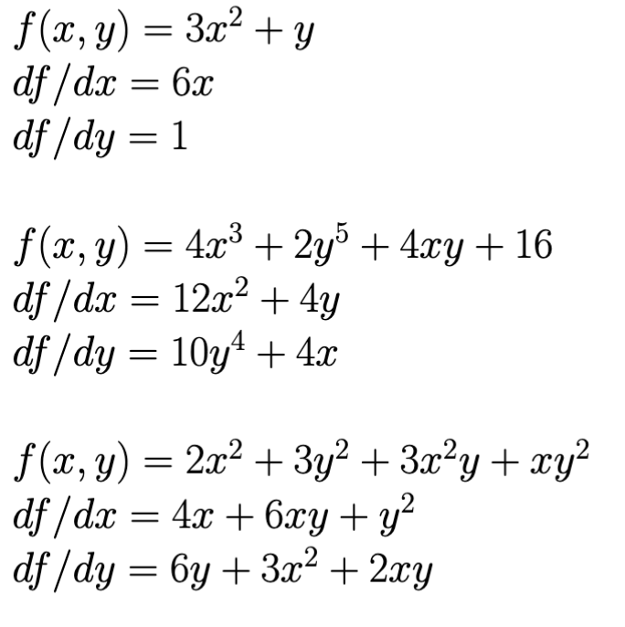

Slide 18
Machine Learning
With python
lin2: linear
algorithms
gradient descent
Notes:
Layout objects pulled from: https://slidesgo.com/
All icons are from: https://thenounproject.com/

Slide 19
Colab workbook
Link: click for access

Slide 20
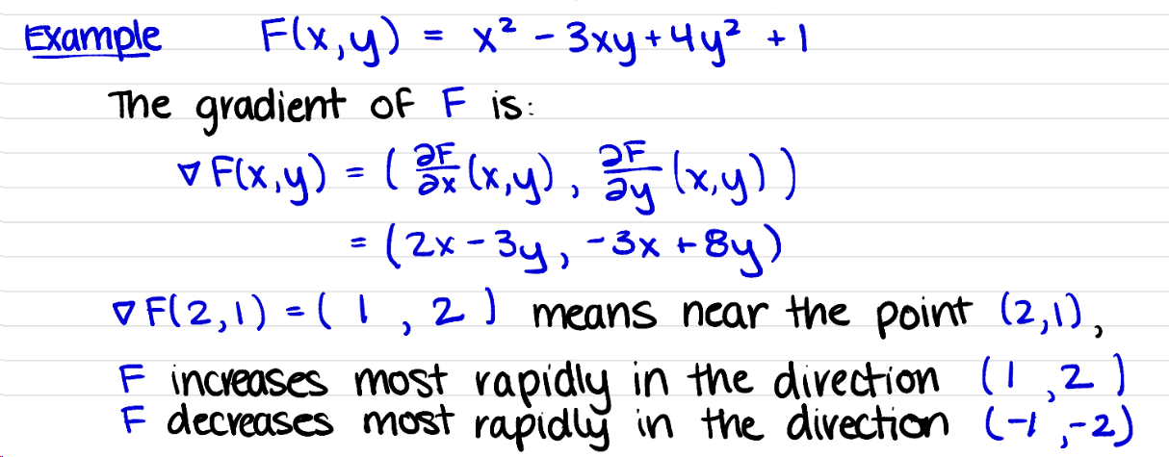
The gradient of a function is a vector, gives the direction in which the function increases the fastest near a point.
We compute the gradient by taking partial derivatives. Update the warm

Slide 21
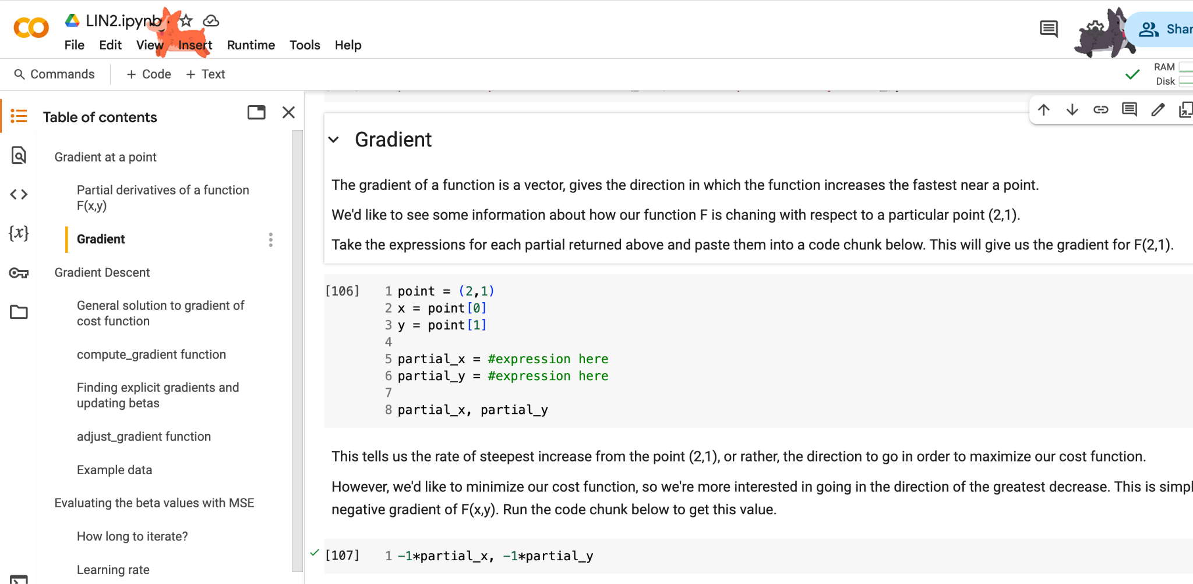
should return

Slide 22
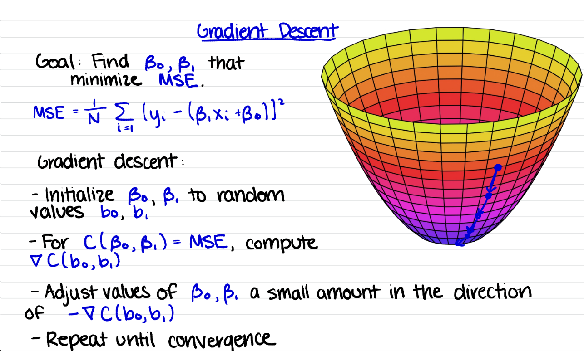

Slide 23
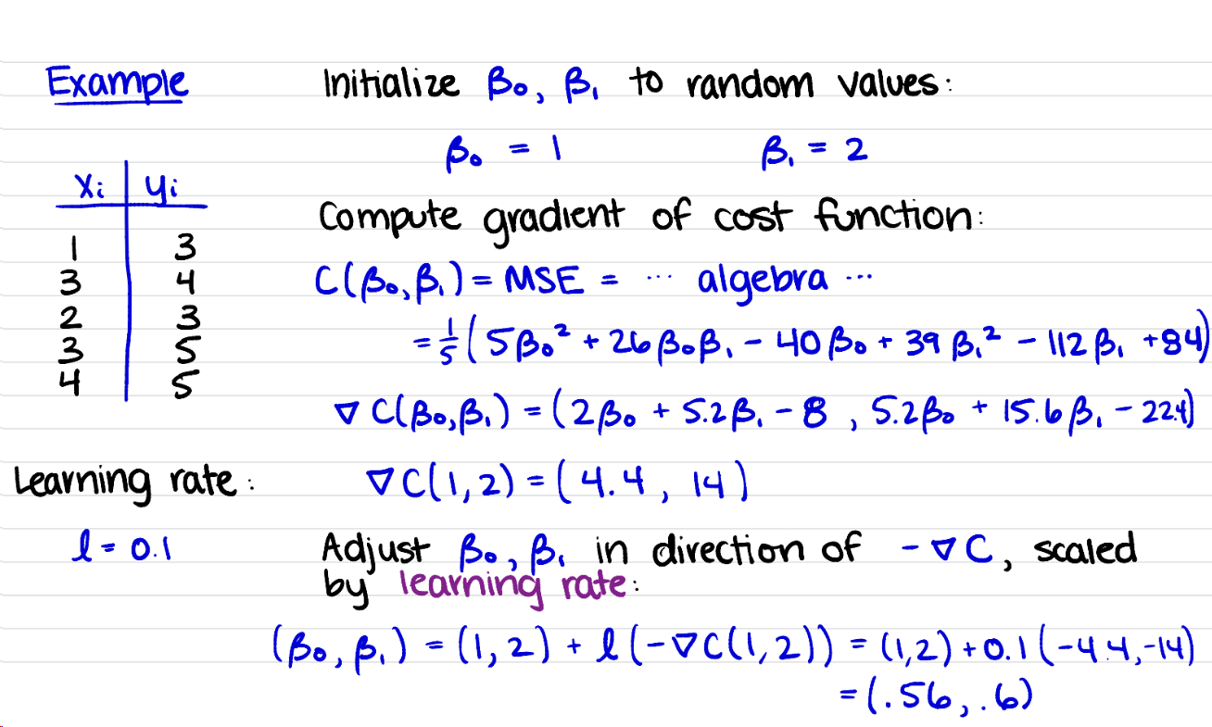

Slide 24
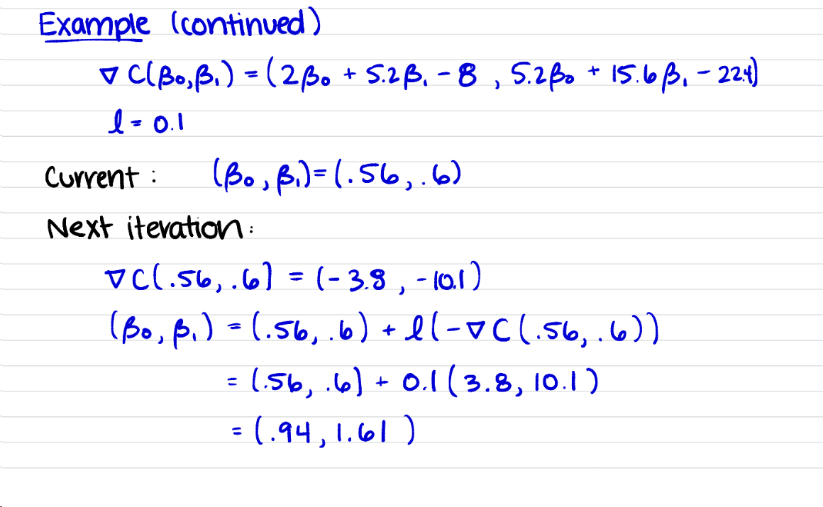

Slide 25
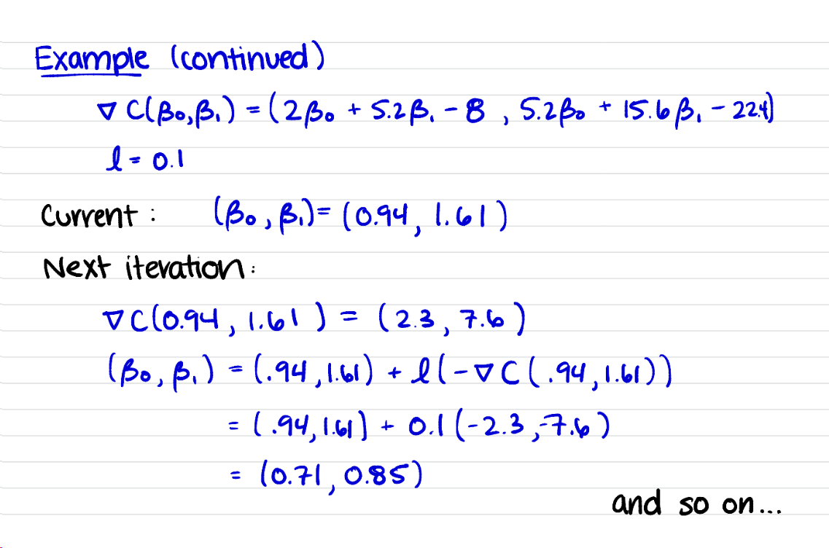

Slide 26
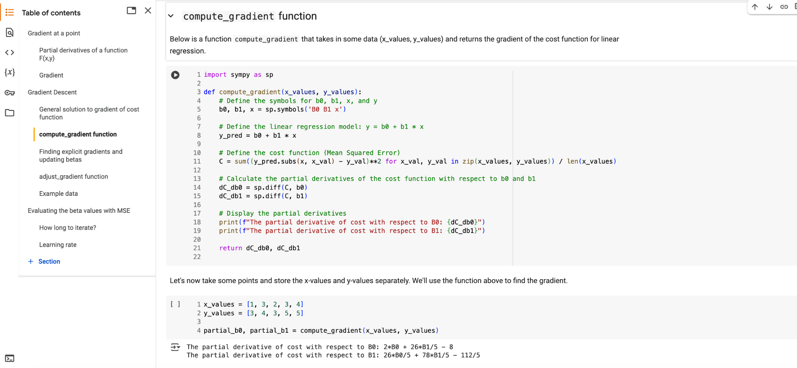
This is the general solution of a gradient for any given beta values

Slide 27
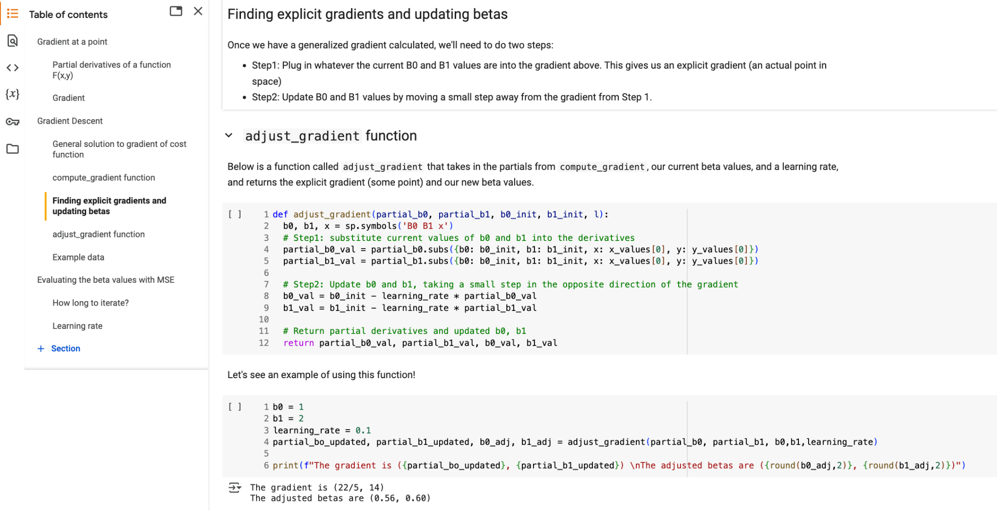

Slide 28
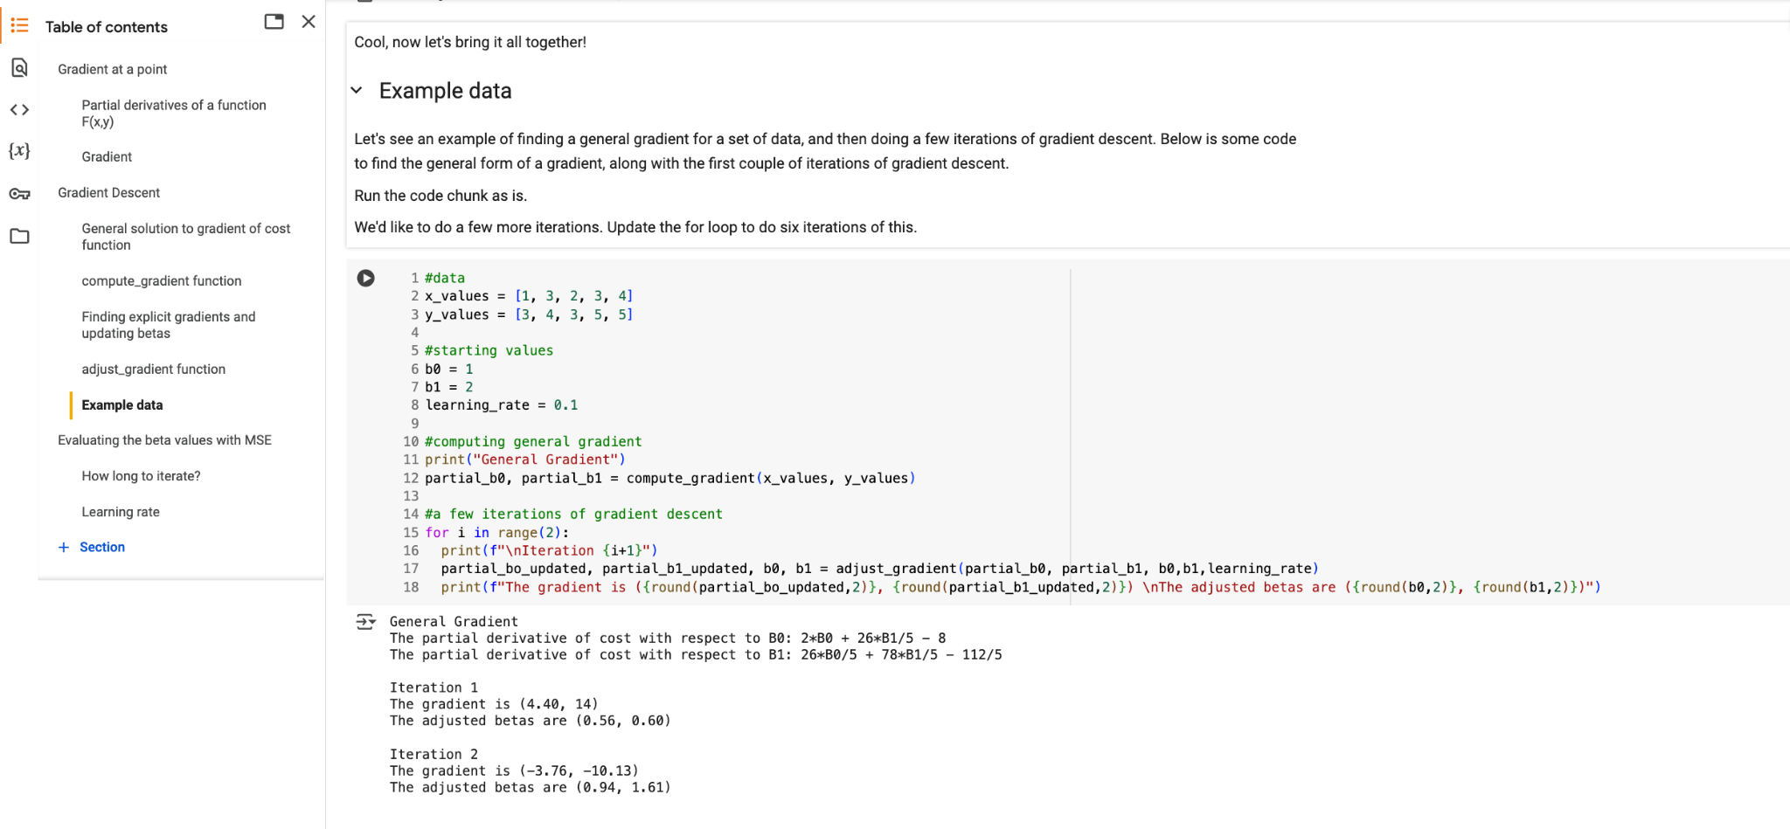

Slide 29
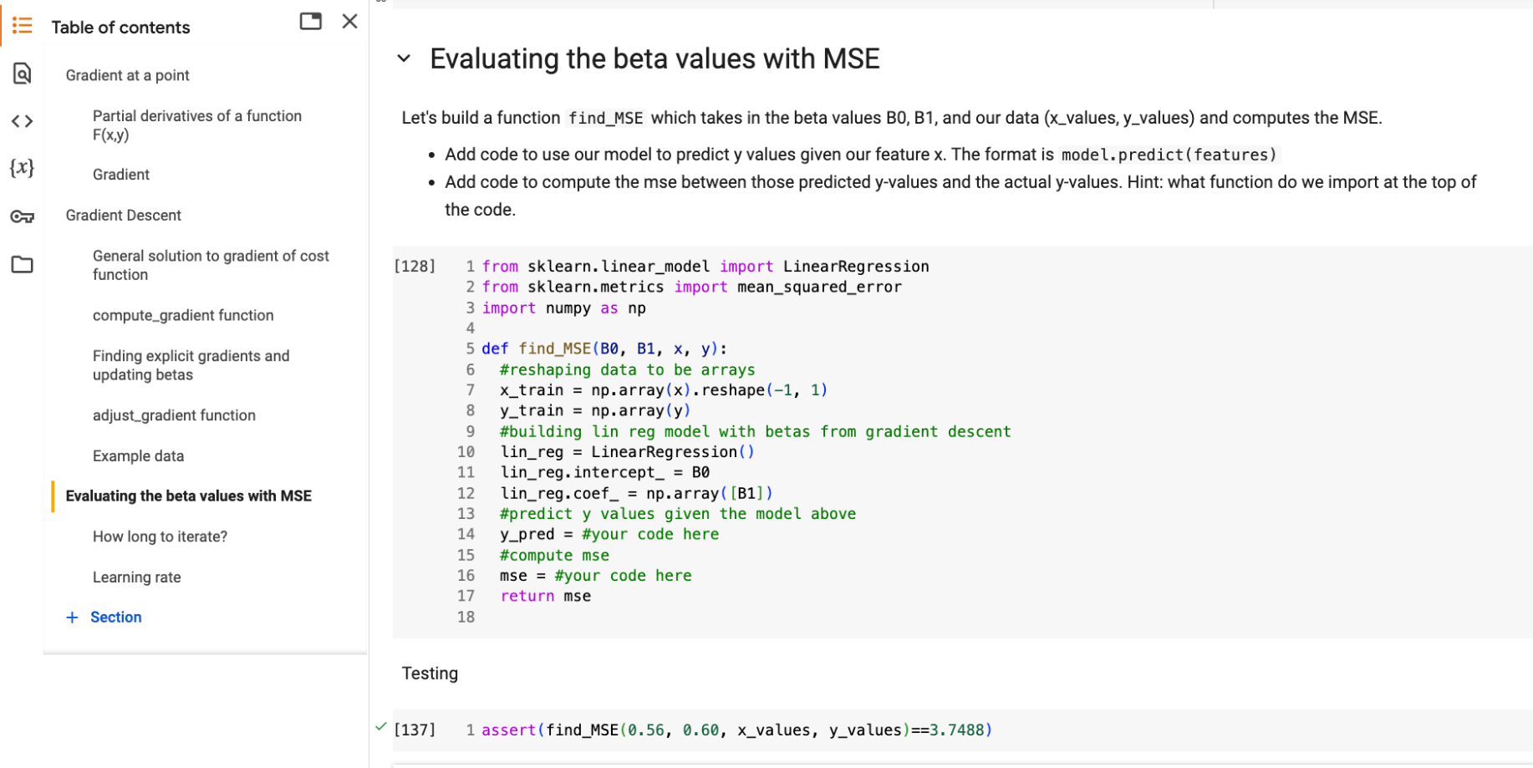

lin_reg.predict(x_train)
mean_squared_error(y_train, y_pred)

Slide 30
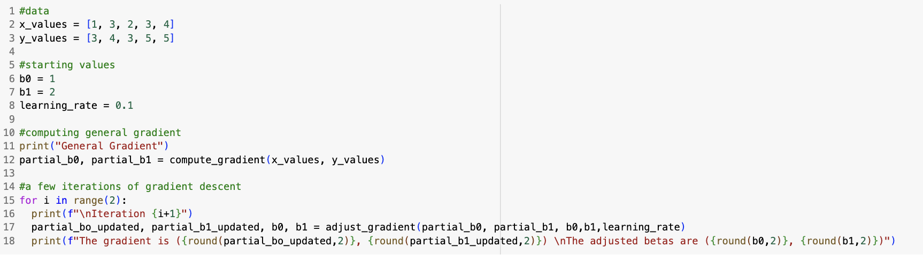
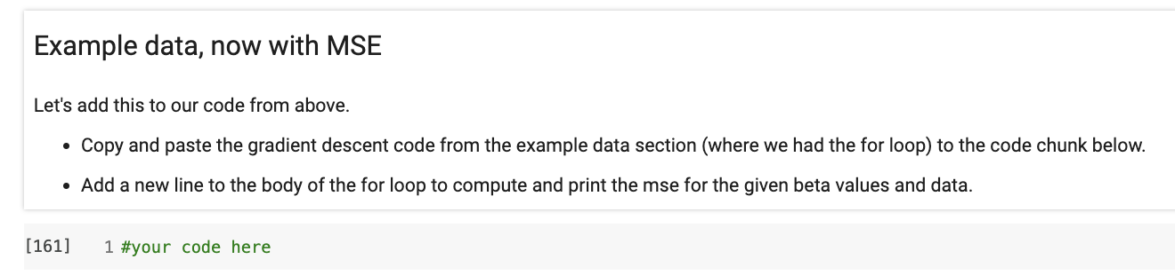
when you’re done, throw an emoji of your favorite animal in chat

Slide 31
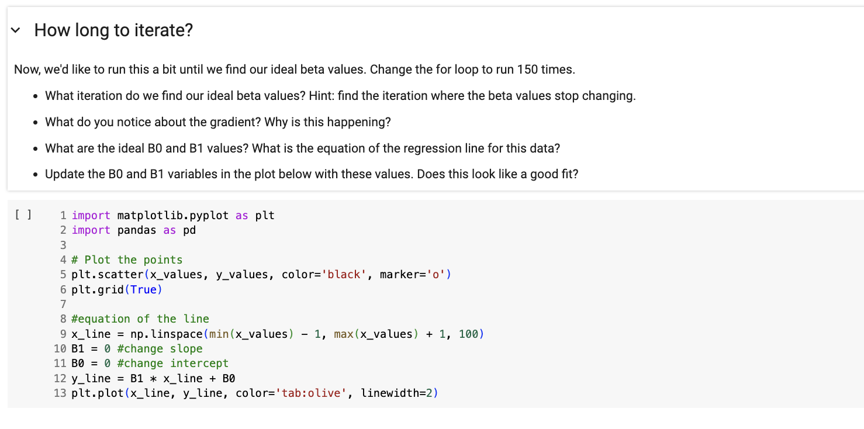
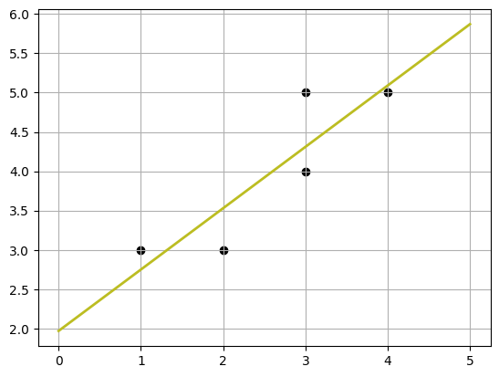
~iteration 140
becomes (0,0), found minima
B0: 1.97 B1: 0.78
y_hat = 0.78x + 1.97
when you’re done, throw an emoji of your favorite color in chat

Slide 32
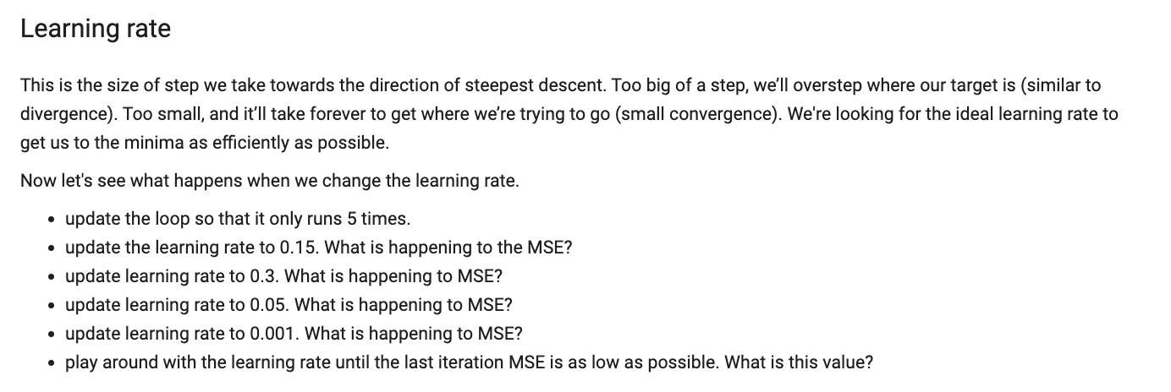
If >0.10 MSE increases drastically (not good)
If <0.05 MSE decreases (good) but slowly
around 0.08, last iteration has MSE of 0.365
when you’re done, throw your favorite emoji in chat

Slide 33

Work Time
HW6
For question 1, you’ll need to do the entire calculations (see slides 31-33), but you can check your answers with the function from our workbook today.
View on our website

Slide 34
Machine Learning
With python
lin3: linear
algorithms
simple + multiple linear model workflow
ridge and lasso regression
Notes:
Layout objects pulled from: https://slidesgo.com/
All icons are from: https://thenounproject.com/

Slide 35
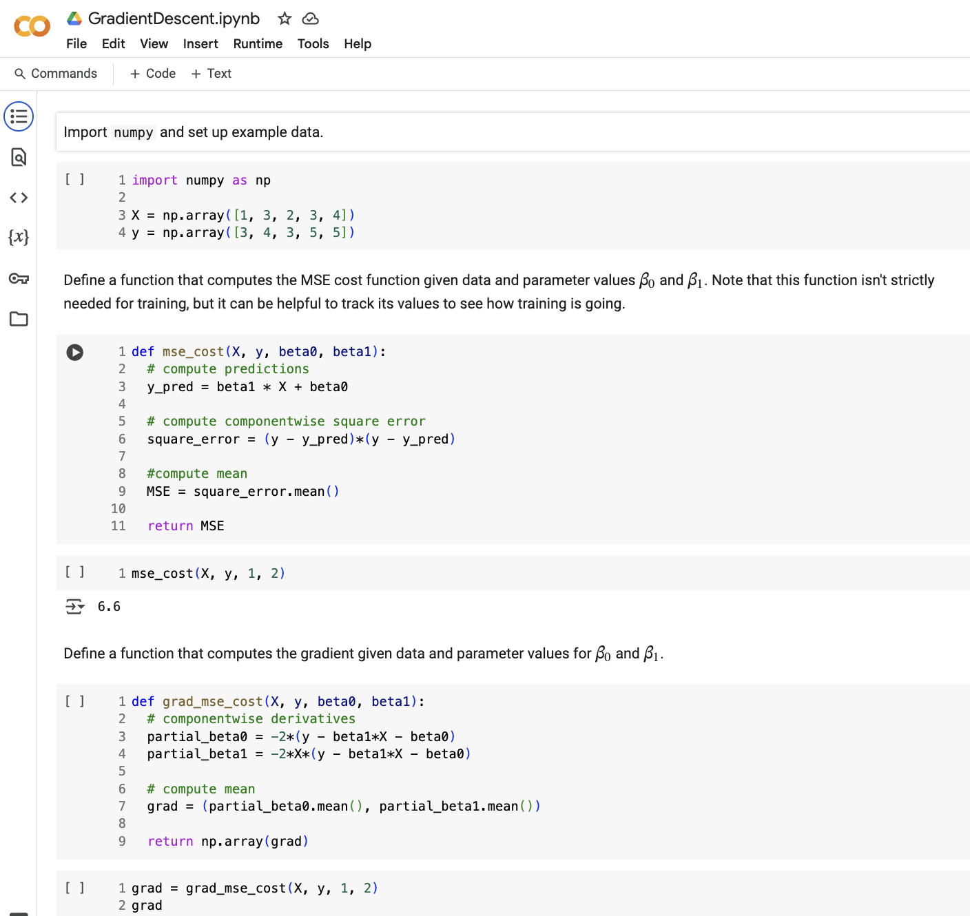
Here is an example of a full end-to-end linear regression model: linear regression from scratch
This is just for illustrative purposes, but is helpful in really understanding how to implement linear regression and gradient descent.

Slide 36
Colab workbook
Link: click for access

Slide 37
Linear Regression Workflow
scale data to standardize
plot data to see if relationships are linear
check correlations between variables
transform the data
train linear regression model
evaluate model
repeat with various transformations

Slide 38
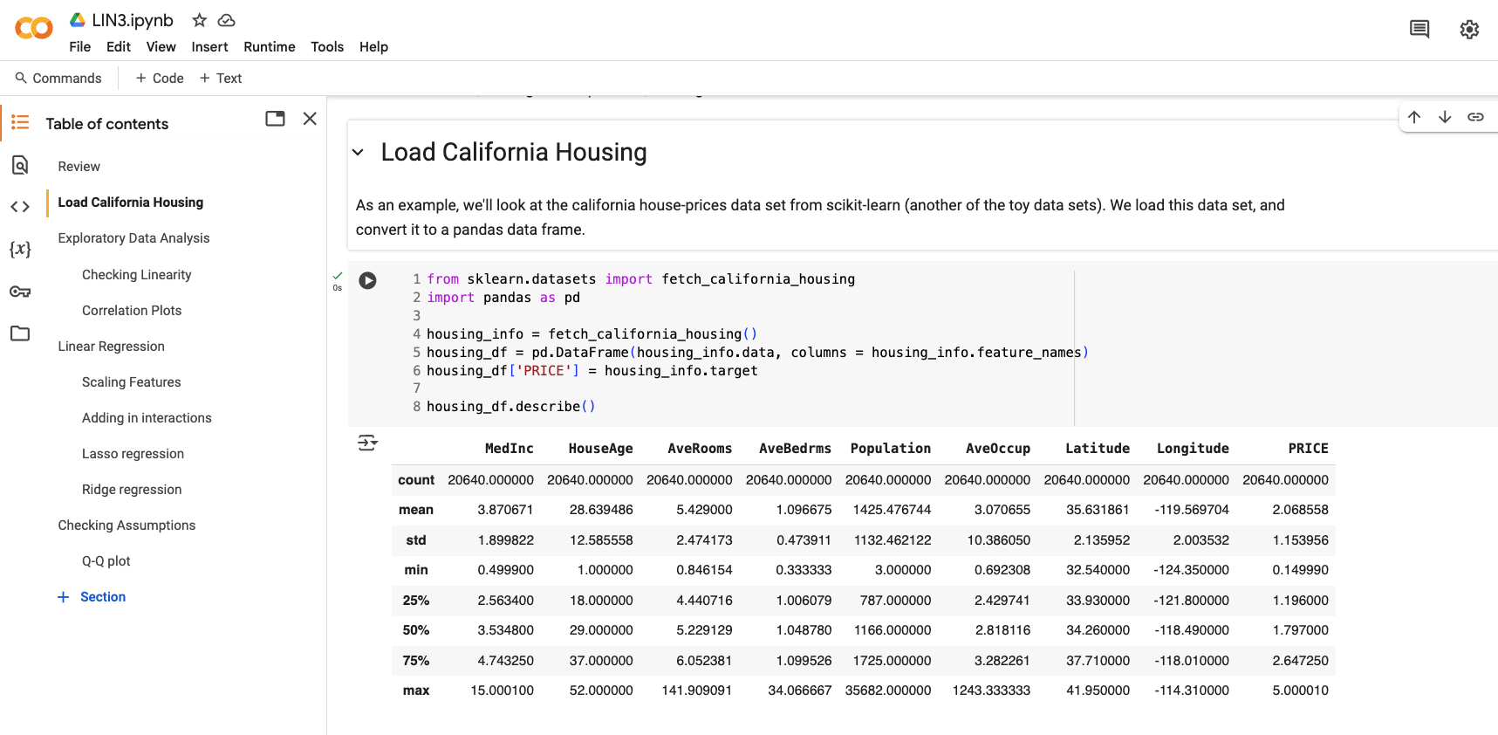

Slide 39
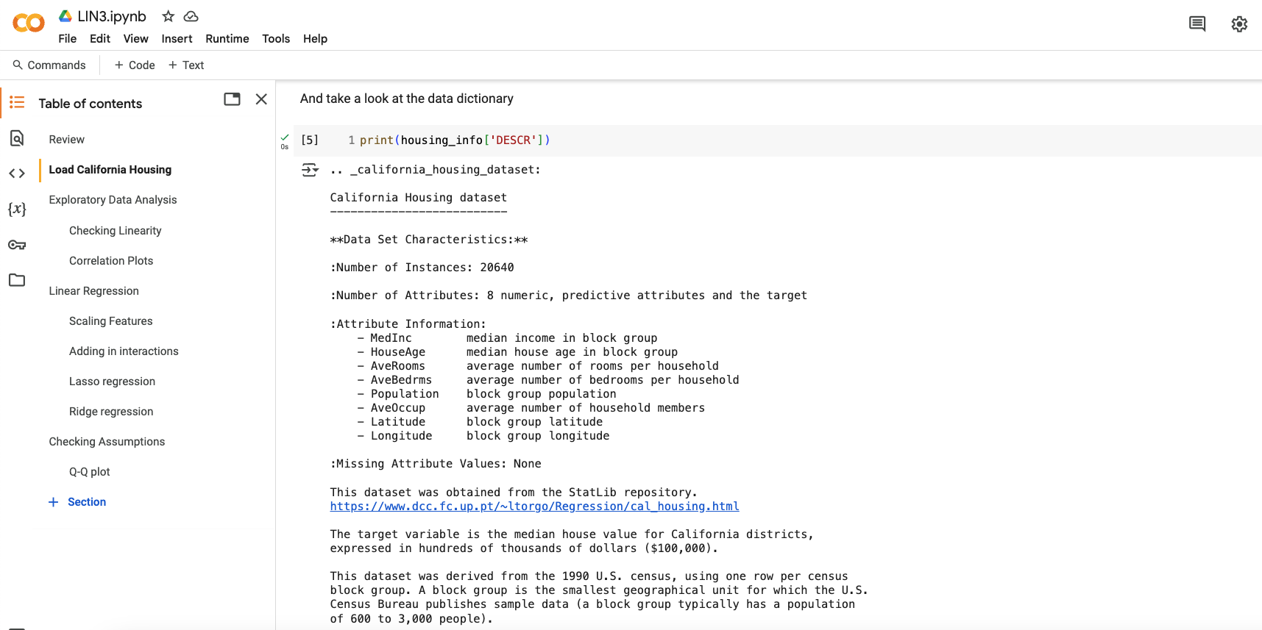

Slide 40
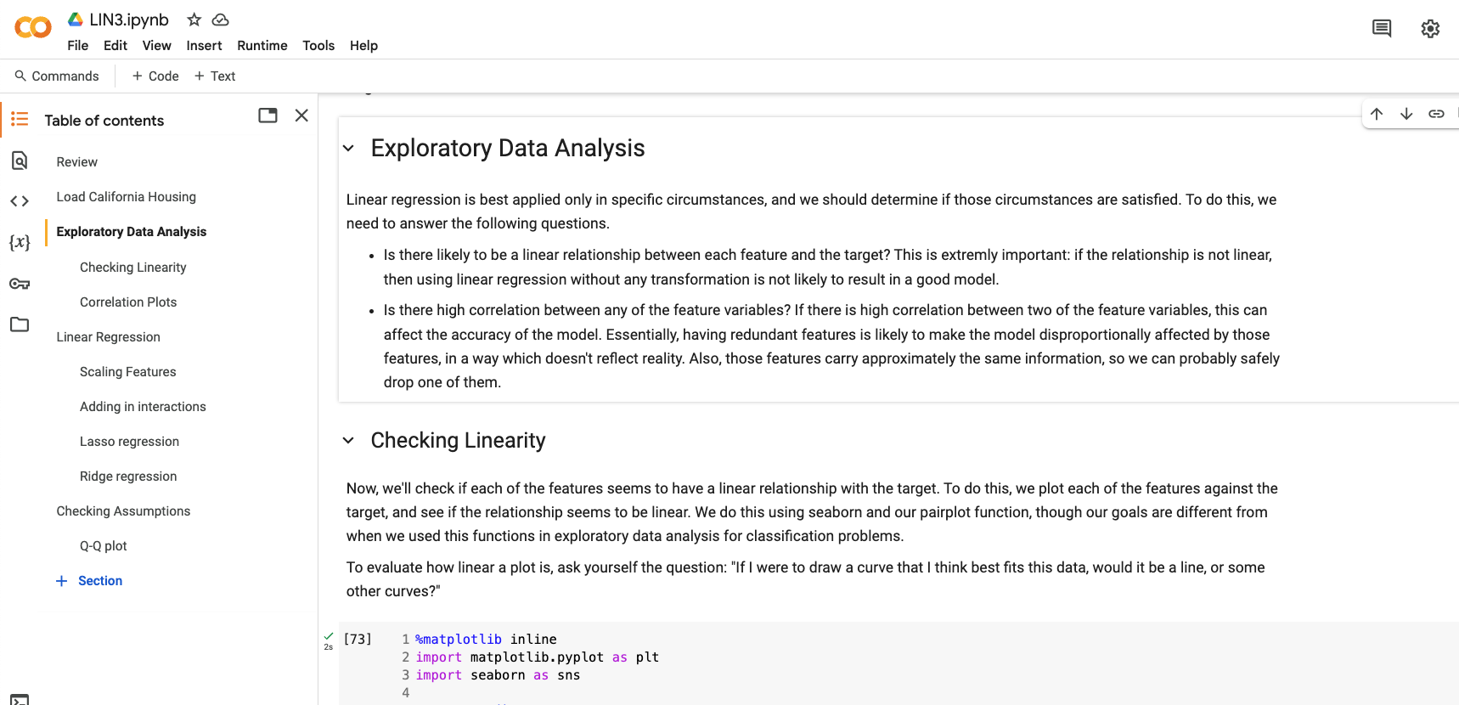

Slide 41
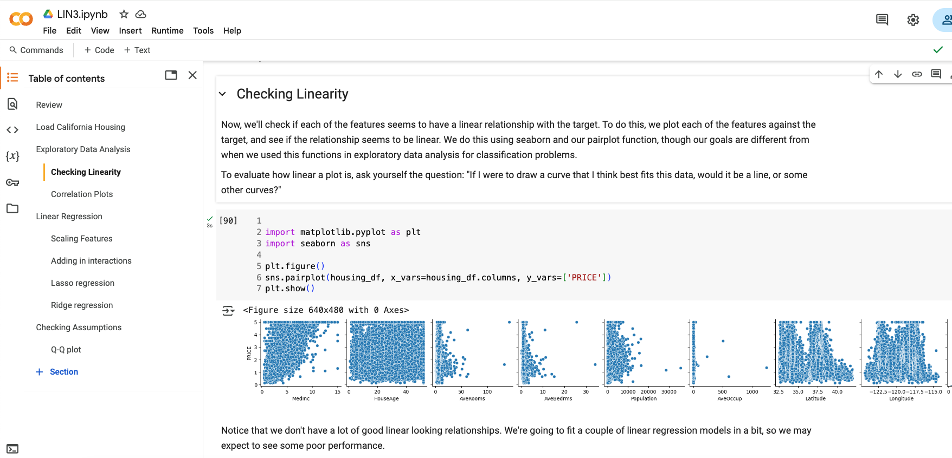

Slide 42
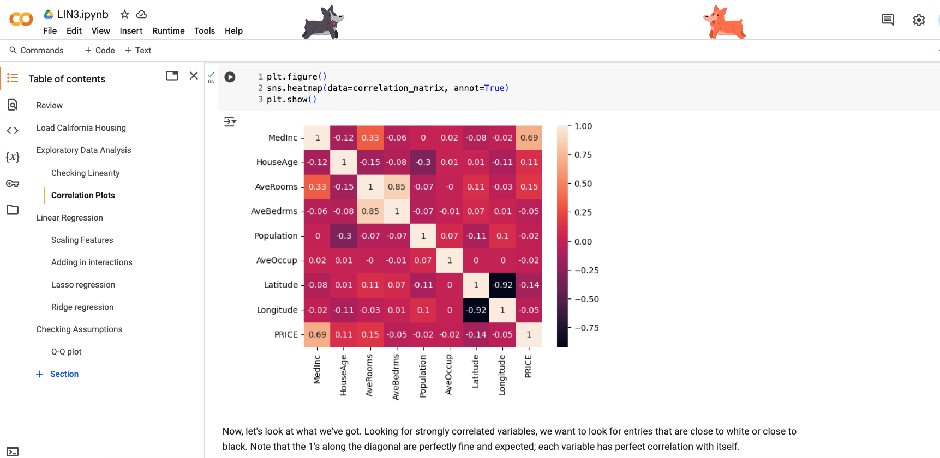

Slide 43
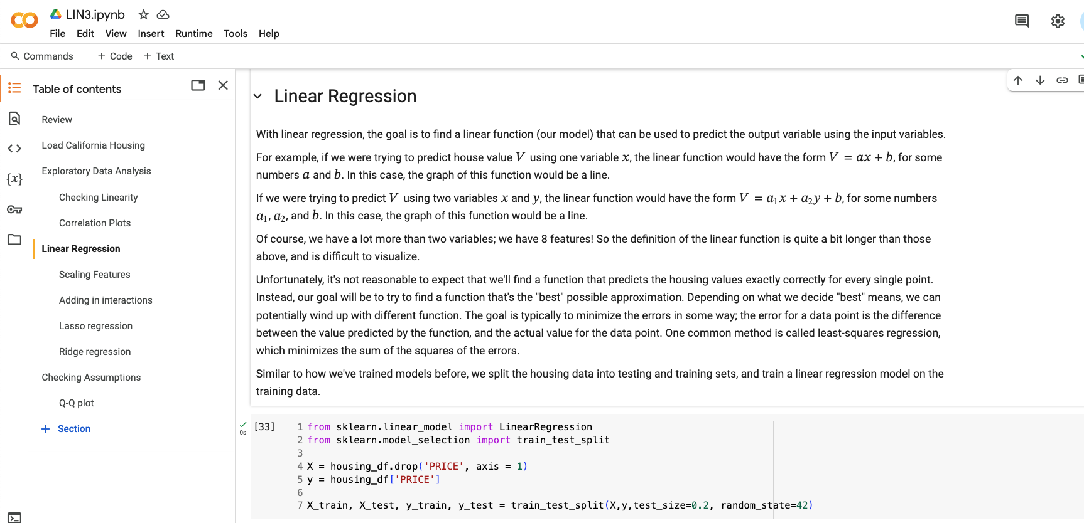

Slide 44
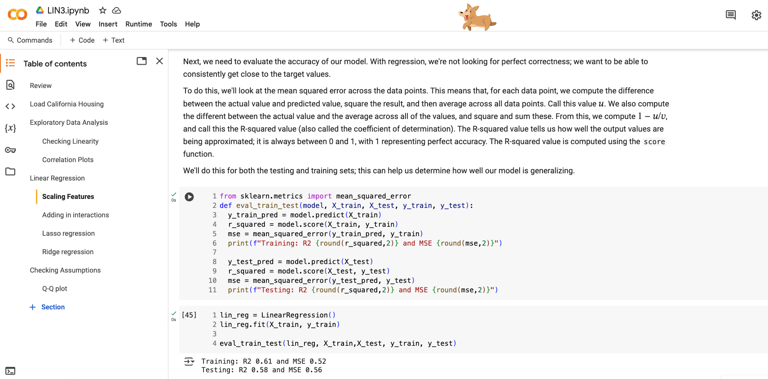
Testing and training are close (good), and an R2 around 0.60 is an okay fit

Slide 45
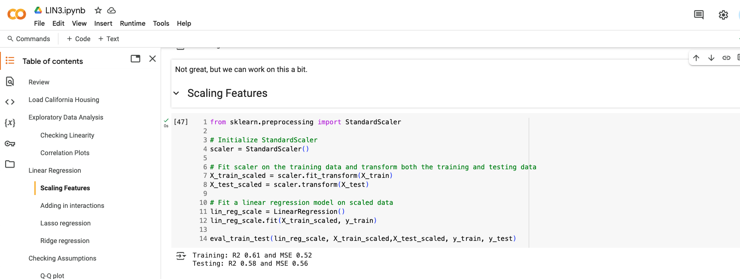
Not much has changed.
Testing and training are close (good), and an R2 around 0.60 is an okay fit

Slide 46
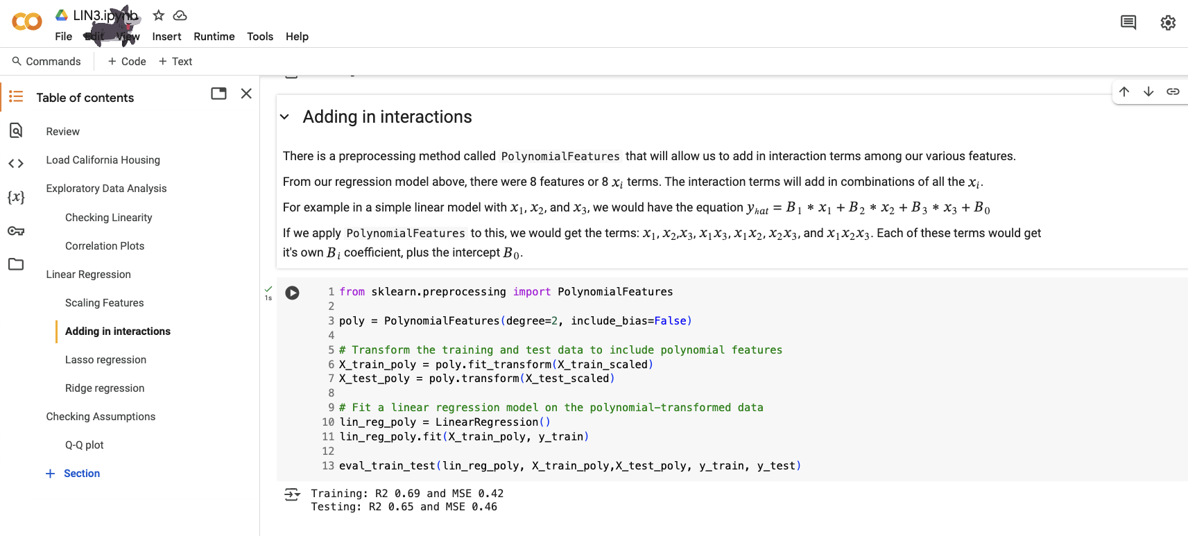
How to do multiple linear regression
Testing and training are close (good), and R2 is increasing.
Typically an R2 between 0.6 and 0.8 is considered a good fit (great would be >0.8)

Slide 47
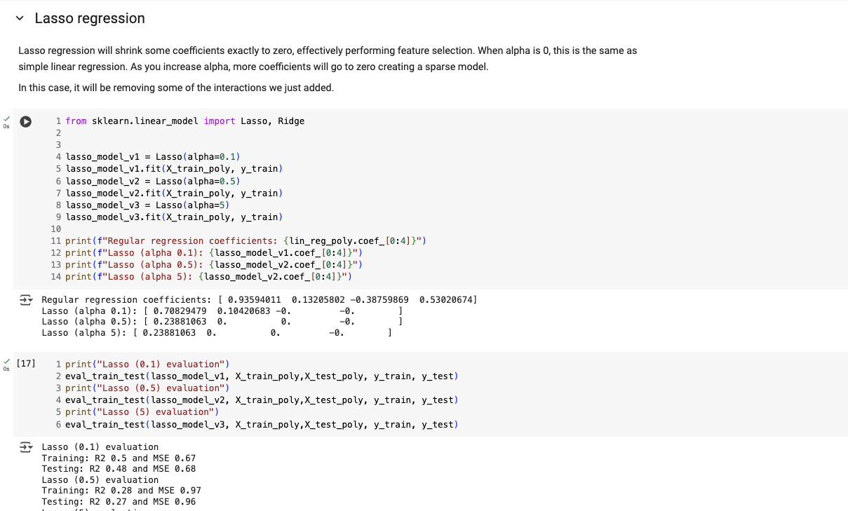
as alpha increases, more Bi coefficients go towards 0.
This causes R2 to drop dramatically. Not the right model for our data
However, if you need help selecting features, this would be a great option

Slide 48
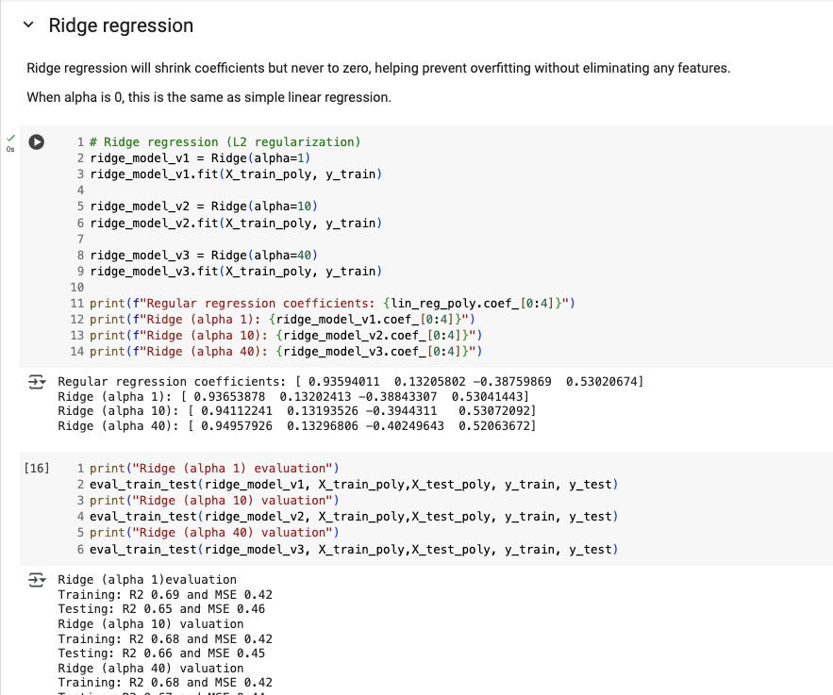
as alpha increases, reduce the influence of terms to prevent overfitting (i.e. reduces the number of features)

Slide 49
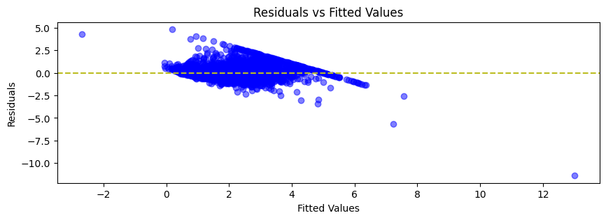
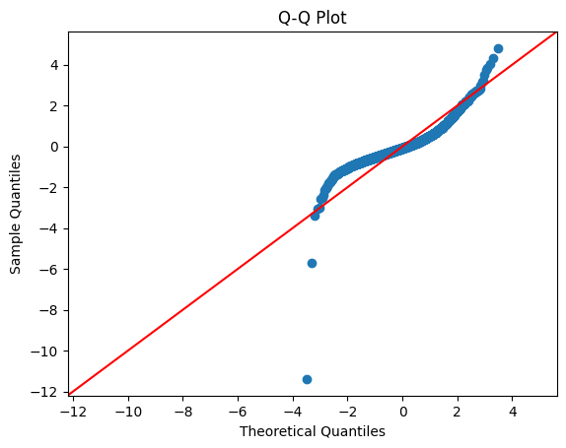
want residuals around zero (close)
We can take a peek at some plots to let us know (along with the correlation and pair plots) whether linear regression is the right fit
Want this to be close to red line. Notice the tails. We added a polynomial term, so this makes some sense.

Slide 50
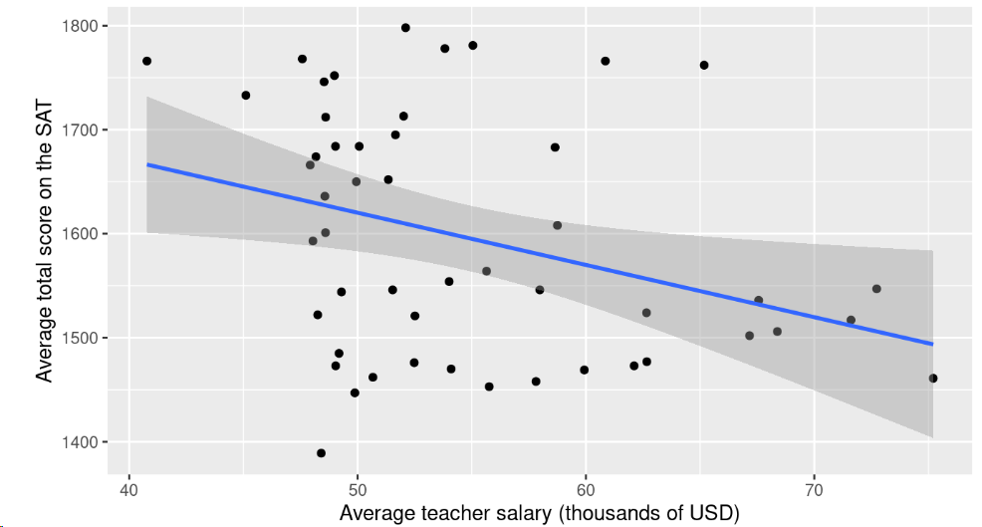
Confounding variables: correlation vs causation
Big Idea: find the line that best fits the data.. but what if there are underlying factors that compound certain relationships?
Teacher performance example: Are higher teacher salaries associated with better outcomes on the test at the state level? If so, should we adjust salaries to improve test performance? Let’s take a look!
Among all states, salaries and SAT scores are negatively associated. Does this sound true?

Slide 51
Confounding variables: correlation vs causation
Let’s take a look at a model with only Xsalary as the predictive feature for our target variable ŷSAT.
Let’s take a look at the model output and see what’s going on:
Our equation becomes:
And we can interpret the estimate for the salary term B to indicate that SAT scores are predicted to decrease 5 points as teacher salary increases by $1k
We can also give a prediction for SAT score given a salary. Let’s take a single record from Xsalary of $60,000. We would predict average SAT scores to be: -5.01*60 +1871 = 1570. Note this should land on the line we fit on the previous slide.
ŷSAT = Bsalary * Xsalary + B0
term estimate std.error statistic p.value
(Intercept) 1871. 113. 16.5 1.86e-21
Salary -5.02 2.05 -2.45 1.79e- 2
ŷSAT = -5.02 * Xsalary + 1871

Slide 52
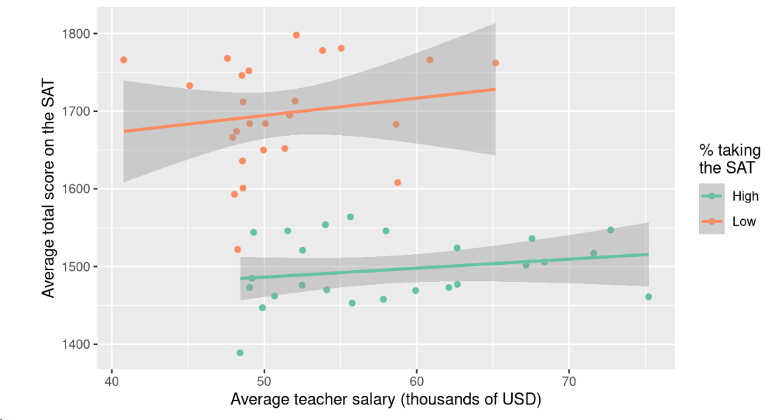
Confounding variables: correlation vs causation
How to address this? straightforward if the confounding variables are measured. You can use stratification where you bin a certain feature into categories and then create a model for each bin. You can also use multiple regression that will incorporate multiple features (more xi) into the equation.
Stratification example:
ŷSAT = Bsalary * Xsalary + B0
SAT_grp term estimate std.error statistic p.value
High (Intercept) 1428. 62.4 22.9 2.51e-17
High Salary 1.16 1.06 1.09 2.85e- 1
Low (Intercept) 1583. 141. 11.2 8.52e-11
Low Salary 2.22 2.75 0.809 4.27e- 1
Fill in the blanks: SAT scores are predicted have about a est point incr/decr per $1k increase in salary for states with a high percentage of students taking the ACT, and about a est point incr/decr per $1k increase in salary for states with a low percentage.
Among states with a low percentage taking the SAT, teacher salaries and SAT scores are positively associated. Same is true for high percentage.

Slide 53
Confounding variables: correlation vs causation
How to address this? straightforward if the confounding variables are measured. You can use stratification where you bin a certain feature into categories and then create a model for each bin. You can also use multiple regression that will incorporate multiple features (more xi) into the equation.
Multiple regression example:
Interpreting models output for:
SAT scores = Bsalary * XSalary + BSAT_perc * XSAT_perc + B0
term estimate std.error statistic p.value
(Intercept) 1589. 58.5 27.2 2.16e-30
Salary 2.64 1.15 2.30 2.62e- 2
SAT_pct -3.55 0.278 -12.8 7.11e-17
Fill in the blanks: SAT scores are predicted have about a est point incr/decr per $1k increase from teacher salary, and about a est point incr/decr per percentage point increase from SAT scores.
Among all states, salaries and SAT scores are positively associated, and % of state takes ACT and SAT scores are negatively associated.

